Slide 1
MINOR PROJECT
TOPIC:-FITVEN

Slide 2
ABSTRACT
In today's health-conscious society, maintaining a balanced diet and fitness routine is crucial for overall well-being. Our web development project aims to revolutionize the way people approach their fitness goals by offering a comprehensive platform that provides personalized calorie tracking, workout planning, and one-on-one support from certified fitness coaches. The website will act as an all-in-one fitness companion, catering to users of all fitness levels and empowering them to lead healthier lives.
The core feature of the website is the advanced calorie calculator, which will enable users to effortlessly track their daily caloric intake and expenditure. The system will consider individual factors such as age, gender, weight, height, and activity level to generate accurate caloric estimates. Additionally, the platform will offer customized workout plans based on users' fitness goals and preferences. These plans will be curated by fitness experts and encompass various exercise routines, from strength training to cardiovascular activities, ensuring a well-rounded approach to fitness.

Slide 3
ABSTRACT
To further enhance the user experience, our website will offer access to a team of professional fitness coaches who provide personalized support and guidance. Users can engage in one-on-one video consultations with the coaches, discussing their progress, challenges, and receiving valuable feedback to optimize their fitness journey. Additionally, the website will foster a vibrant fitness community, where users can interact, share their success stories, and motivate each other towards achieving their goals.
Through cutting-edge technology and user-friendly interfaces, our web development project ensures that users can easily navigate the platform and access valuable resources to meet their fitness objectives. The website will feature a sleek and intuitive design, making it compatible with various devices, including desktops, tablets, and smartphones, for seamless usage on the go.

Slide 4
ABSTRACT
To maintain data accuracy and security, the website will implement robust data encryption and adhere to strict privacy policies. Users can trust that their personal information, including sensitive health data, will remain confidential and protected at all times. Regular updates and continuous improvement of the platform will be conducted based on user feedback and emerging trends in the fitness industry

Slide 5
MODULES
ADMINISTRATOR
USER
TRAINER/INFLUENCER

Slide 6
MODULE DISCRIPTION
ADMINISTRATOR
a) User Management: The administrator will handle user registrations, account approvals, and user profile management.
b) Content Management: The administrator will oversee the content published on the website, including workout plans, articles, and other resources. They may collaborate with fitness experts and content creators to ensure that the information provided is accurate, up-to-date, and aligned with the website's goals.
c) Fitness Coach Management: As part of the fitness coach support feature, the administrator will be responsible for recruiting, onboarding, and managing the fitness coaches. They will ensure that the coaches are qualified, certified, and deliver high-quality support to the users.

Slide 7
MODULE DESCRIPTION
USER
Personal Fitness Management: Users will utilize the website to manage their personal fitness goals effectively. They will input their relevant information, such as age, gender, weight, height, and activity level, into the calorie calculator, enabling the system to generate accurate caloric estimates based on their individual needs.
Calorie Tracking: The user will use the calorie tracking feature to monitor their daily caloric intake and expenditure. By logging their meals and physical activities, users can gain insights into their nutrition and exercise habits, helping them make informed decisions about their dietary choices and fitness routines.
Workout Planning: Users will benefit from the personalized workout plans offered by the website. Based on their fitness goals, preferences, and fitness levels, users can access a variety of exercise routines curated by fitness experts.

Slide 8
MODULE DESCRIPTION
TRAINER/INFLUENCER
Personalized Coaching: The fitness coach will interact with users on a one-on-one basis, offering personalized coaching based on each user's specific fitness objectives, preferences, and physical condition. They will take into account the user's health history, fitness level, and any limitations to tailor workout plans and dietary recommendations accordingly.
Goal Setting and Progress Monitoring: Coaches will work with users to establish realistic and achievable fitness goals. They will regularly monitor the user's progress, tracking performance, and providing feedback to ensure that users stay on track and make steady progress towards their targets.

Slide 9
Customized Workout Plans: The fitness coach will design customized workout plans that align with the user's goals, preferences, and fitness level. These plans may include a mix of strength training, cardio exercises, flexibility routines, and more, ensuring a well-rounded and effective approach to fitness.
Nutritional Guidance: Coaches will offer nutritional guidance to complement the user's workout routine. They will help users make informed decisions about their diet, recommending appropriate meal plans, and providing tips for maintaining a balanced and healthy diet.
Motivation and Support: The fitness coach will act as a source of motivation and encouragement throughout the user's fitness journey. They will celebrate successes, provide support during challenges, and offer motivation to keep users engaged and committed to their goals.

Slide 10
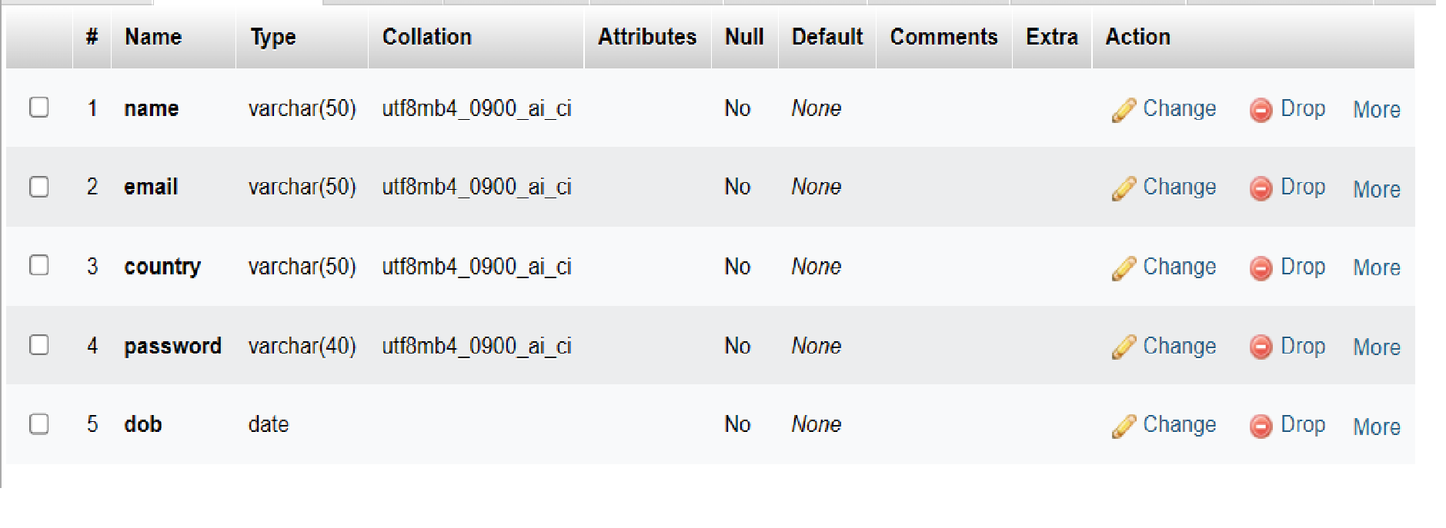
Signup Table.

Slide 11
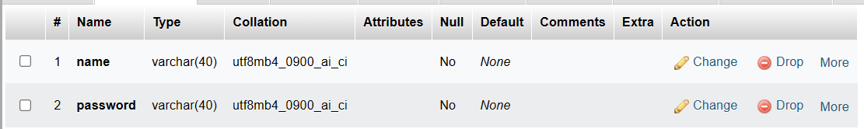
Login Table

Slide 12
TRAINER TABLE
# | NAME | TYPE | COLLATTION | ATTRIBUTE | NULL | DEFAULT | COMMENTS
1 | Name | Varchar(40) | uttf8mp4_0900_ai_ci |  | No | None
2 | Email | Varchar(40) | uttf8mp4_0900_ai_ci |  | No | None
3 | Password | Varchar(40) | uttf8mp4_0900_ai_ci |  | No | None
4 | Certificate | Varchar(40) | uttf8mp4_0900_ai_ci |  | No | None

Slide 13
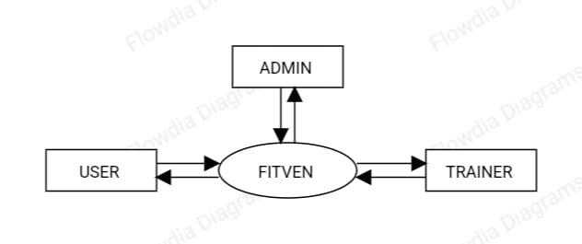
DATAFLOW DIAGRAM OF FITVEN
LEVEL:0

Slide 14
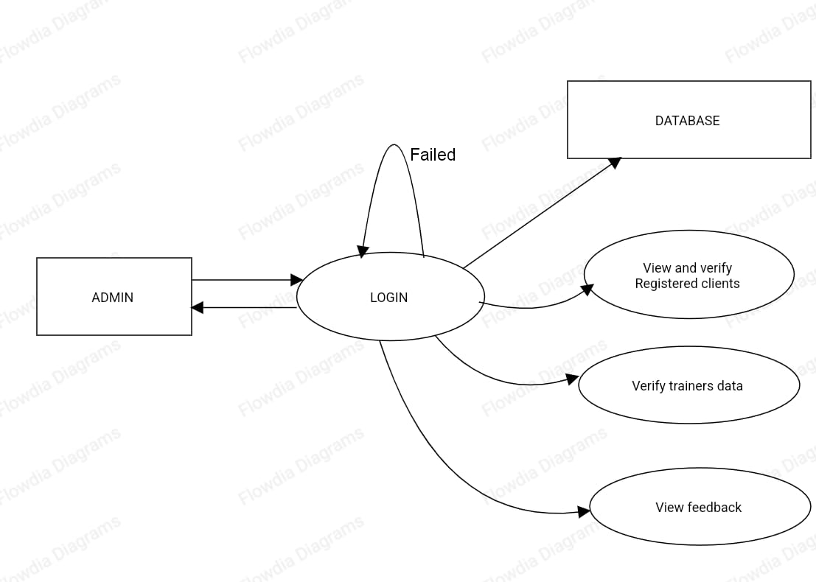
DATAFLOW DIAGRAM OF FITVEN
LEVEL:1

Slide 15
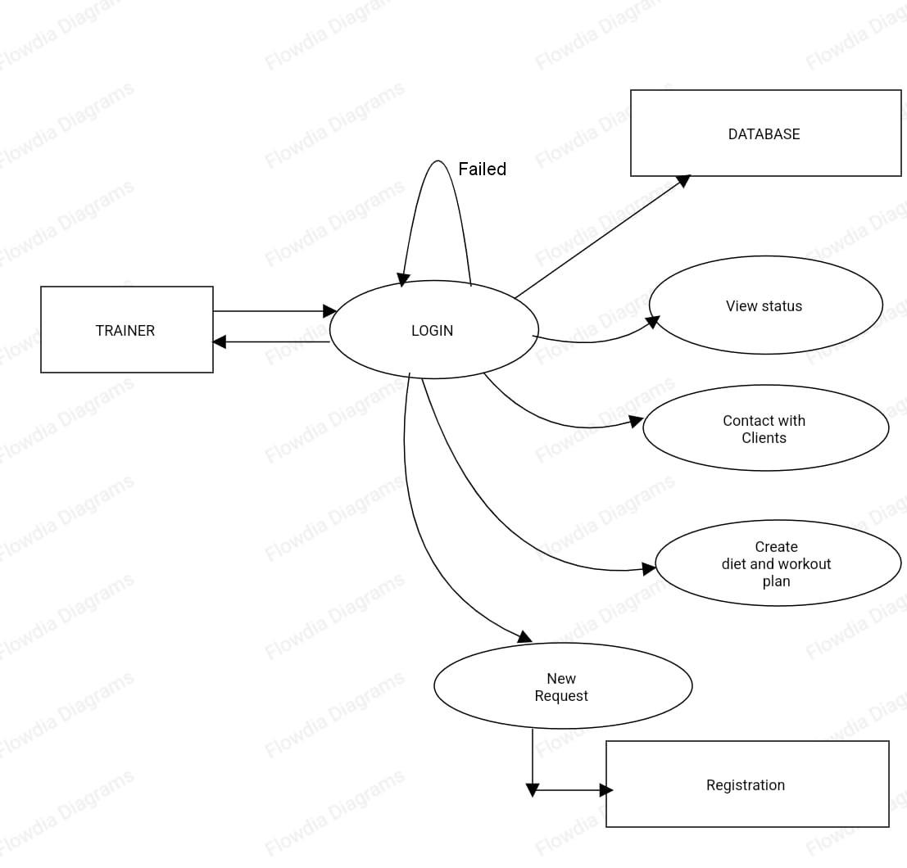
DATAFLOW DIAGRAM OF FITVEN
LEVEL:2

Slide 16
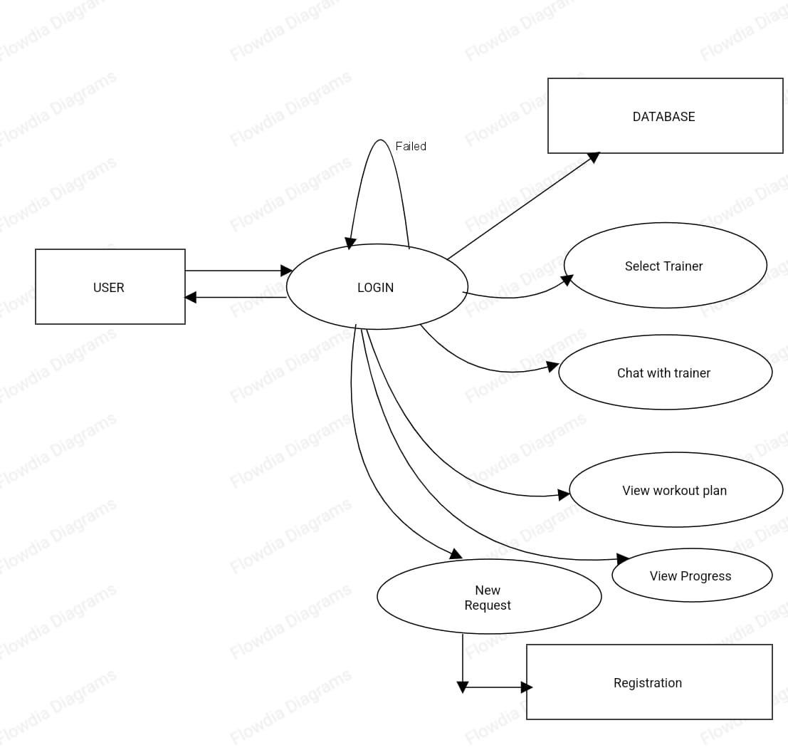
LEVEL:3

Slide 17
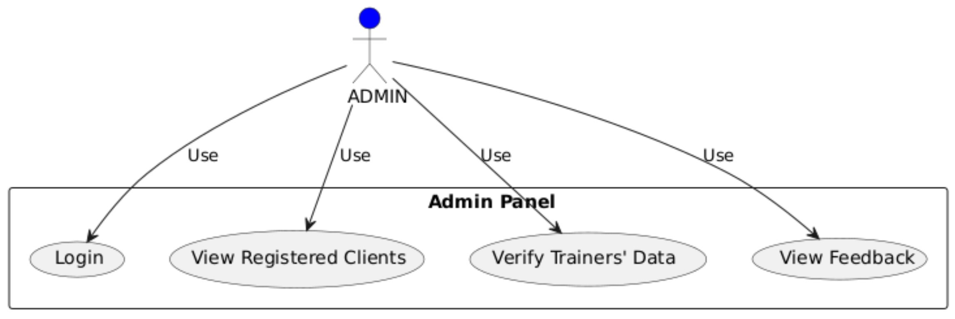
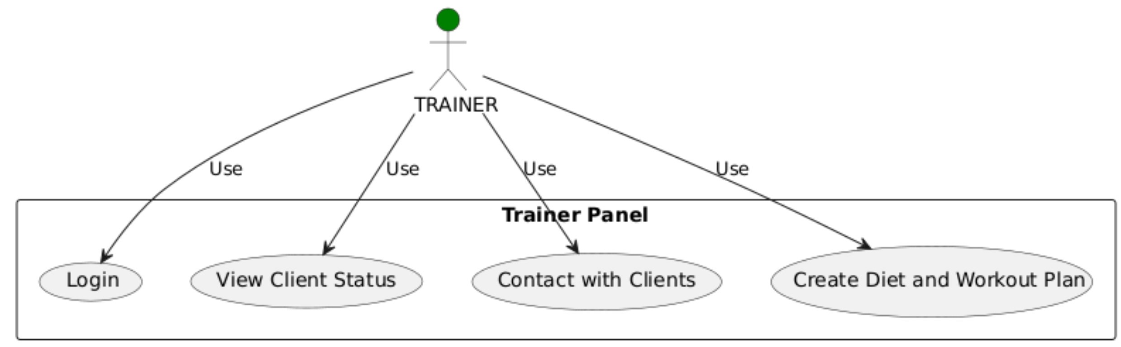
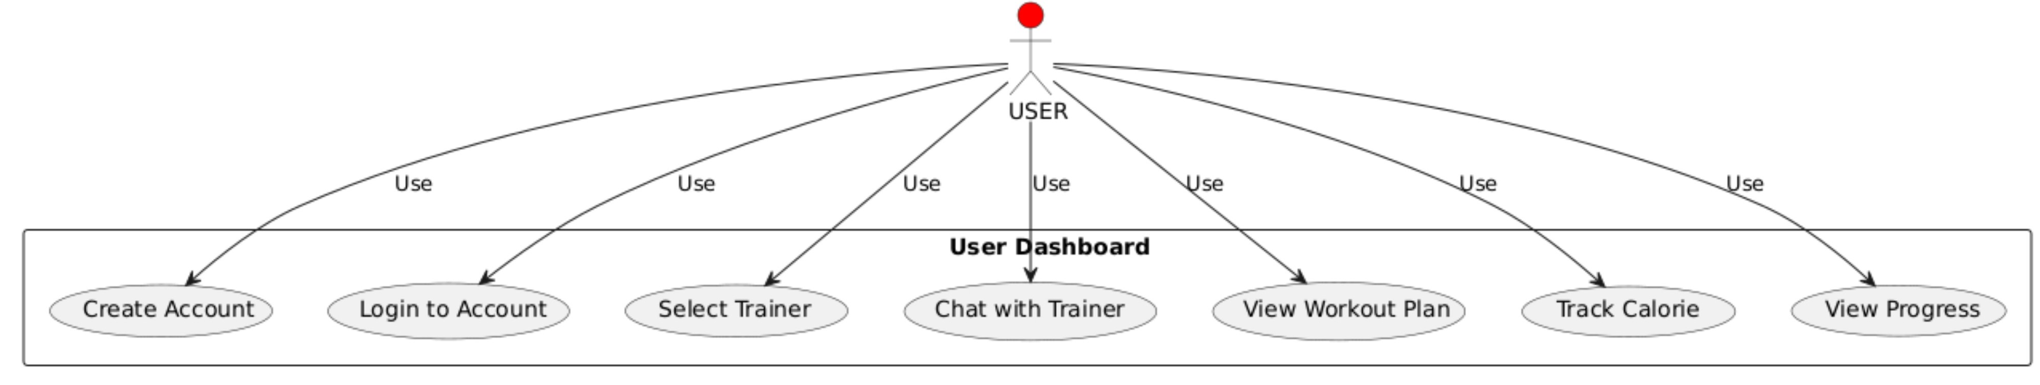
USECASE DIAGRAM OF FITVEN

